Slide 1
Amrita School of Artificial Intelligence, Faridabad
Amrita Vishwa Vidyapeetham
Course Code: 23MAT214
Mathematics for Intelligent System-4
Part- 1.4
The Kronecker Products
BTech 4th Sem
*All Sources: Stanford University, Texas Tech University, UC Santa Barbara, etc.
*Sharing or distributing this lecture material without the permission of the lecture coordinator is strictly prohibited.

Slide 2
Why Do We Need Kronecker Product?
In previous lectures:
• Shift matrix modeled translation
• Circulant matrix modeled periodic convolution
But real systems are often:
• 2D (images)
• Extend 1D systems to 2D
• Multi-channel signals
• Block structured systems
We need a way to build large structured matrices from smaller ones.
That is the Kronecker product.

Slide 3
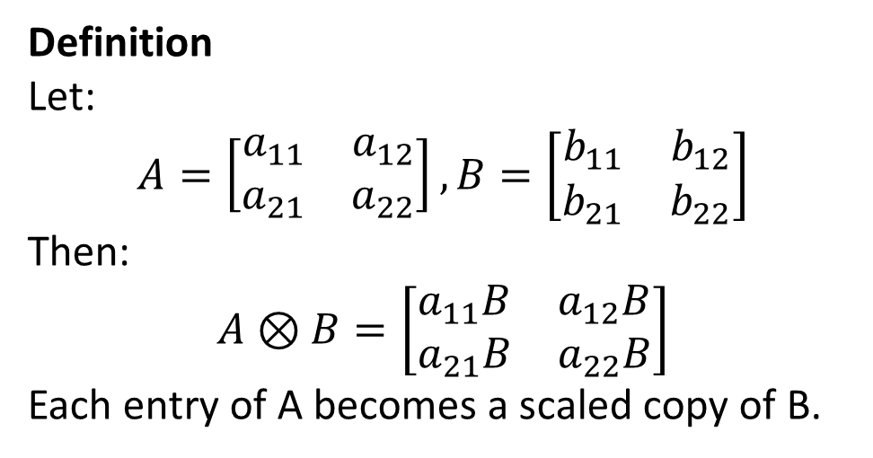
Definition
Let:
$$A=\left[\begin{matrix}a_{11} & a_{12} \\ a_{21} & a_{22}\end{matrix}\right], B=\left[\begin{matrix}b_{11} & b_{12} \\ b_{21} & b_{22}\end{matrix}\right]$$
Then:
$$A⊗B=\left[\begin{matrix}a_{11}B & a_{12}B \\ a_{21}B & a_{22}B\end{matrix}\right]$$
Each entry of A becomes a scaled copy of B.

Slide 4
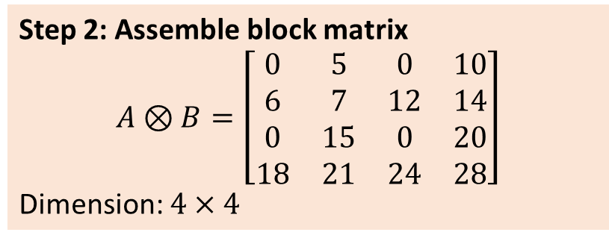
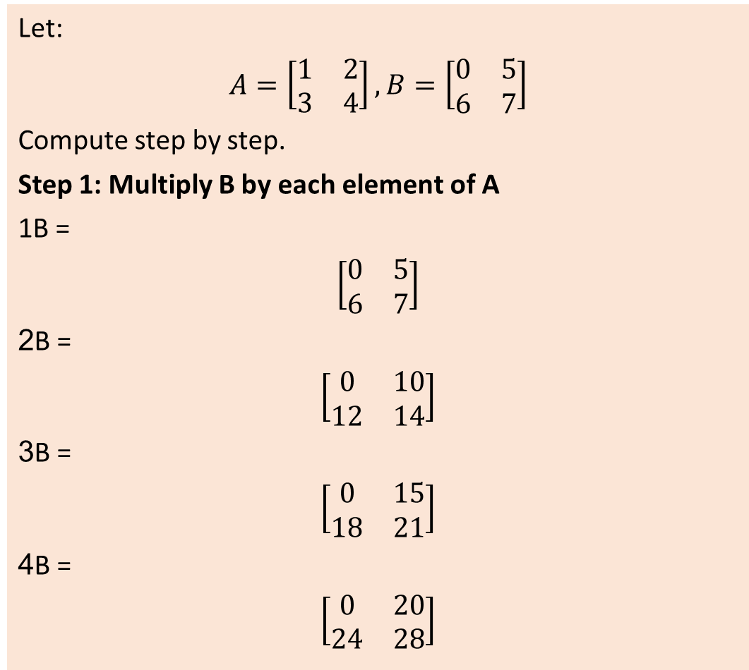
Full Numerical Example
Let:
$$A=\left[\begin{matrix}1 & 2 \\ 3 & 4\end{matrix}\right], B=\left[\begin{matrix}0 & 5 \\ 6 & 7\end{matrix}\right]$$
Compute step by step.
Step 1: Multiply B by each element of A
1B =
$$\left[\begin{matrix}0 & 5 \\ 6 & 7\end{matrix}\right]$$
2B =
$$\left[\begin{matrix}0 & 10 \\ 12 & 14\end{matrix}\right]$$
3B =
$$\left[\begin{matrix}0 & 15 \\ 18 & 21\end{matrix}\right]$$
4B =
$$\left[\begin{matrix}0 & 20 \\ 24 & 28\end{matrix}\right]$$
Step 2: Assemble block matrix
$$A⊗B=\left[\begin{matrix}0 & 5 & 0 & 10 \\ 6 & 7 & 12 & 14 \\ 0 & 15 & 0 & 20 \\ 18 & 21 & 24 & 28\end{matrix}\right]$$
Dimension: $4×4$

Slide 5
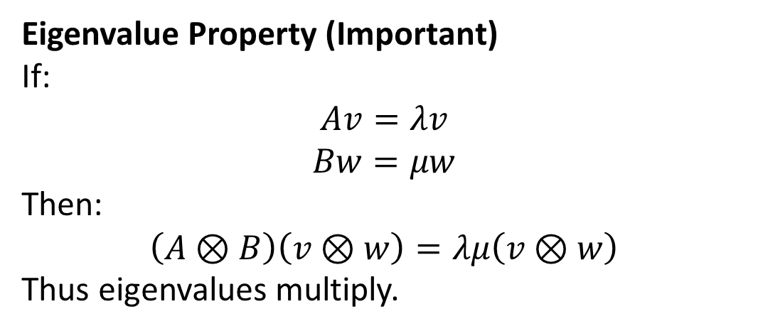
Eigenvalue Property (Important)
If:
$$Av=λv$$
$$Bw=μw$$
Then:
$$\left(A⊗B\right)\left(v⊗w\right)=λμ\left(v⊗w\right)$$
Thus eigenvalues multiply.

Slide 6
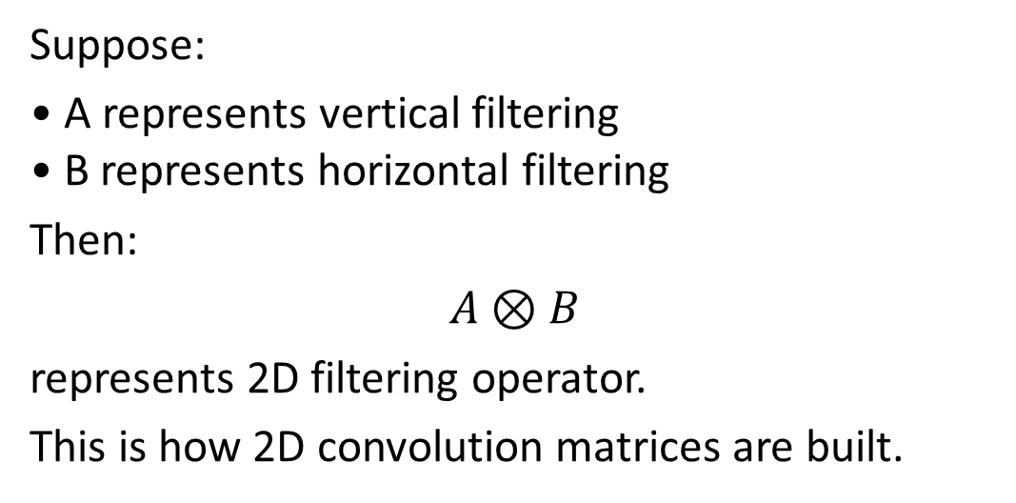
Real-Life Scenario: 2D Image Processing
Suppose:
• A represents vertical filtering
• B represents horizontal filtering
Then:
$$A⊗B$$
represents 2D filtering operator.
This is how 2D convolution matrices are built.
Why Kronecker Appears
Because:
2D separable filtering = vertical operation × horizontal operation.
Kronecker naturally combines independent dimensions.

Slide 7
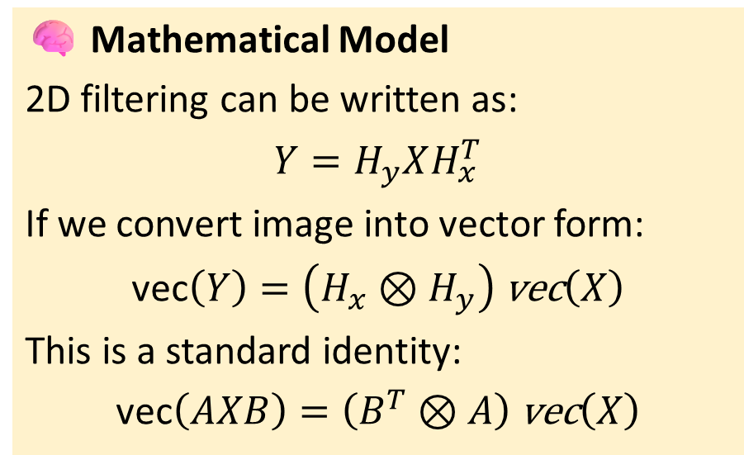
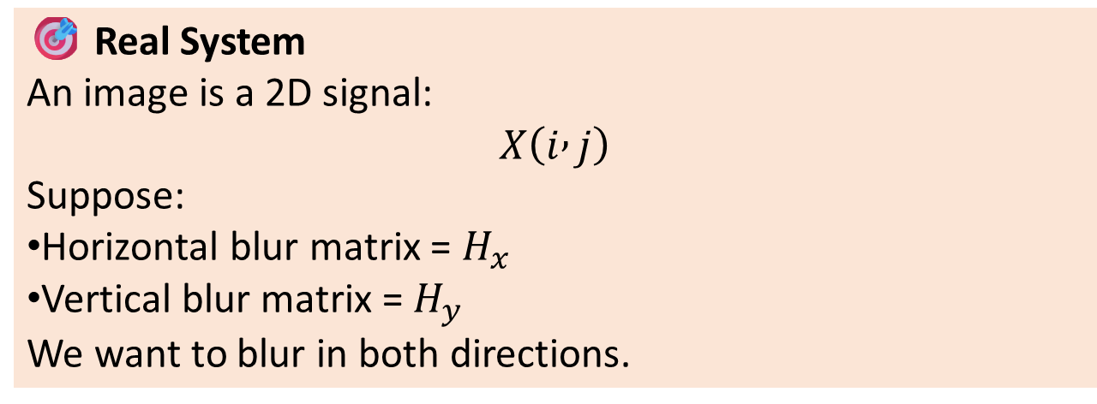
Real-Life Scenario: 2D Image Blurring
🎯 Real System
An image is a 2D signal:
$$X\left(i , j\right)$$
Suppose:
Horizontal blur matrix = $H_{x}$
Vertical blur matrix = $H_{y}$
We want to blur in both directions.
🧠 Mathematical Model
2D filtering can be written as:
$$Y=H_{y}XH_{x}^{T}$$
If we convert image into vector form:
$$\text{vec}\left(Y\right)=\left(H_{x}⊗H_{y}\right) \text{vec}\left(X\right)$$
This is a standard identity:
$$\text{vec}\left(AXB\right)=\left(B^{T}⊗A\right) \text{vec}\left(X\right)$$

Slide 8
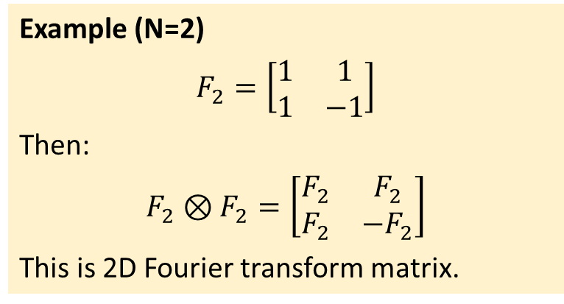
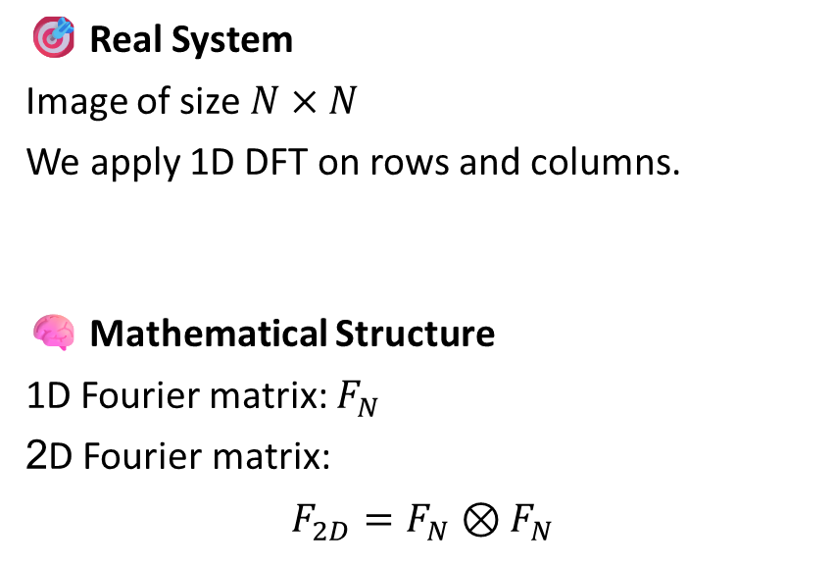
Real-Life Scenario: 2D Discrete Fourier Transform
🎯 Real System
Image of size $N×N$
We apply 1D DFT on rows and columns.
🧠 Mathematical Structure
1D Fourier matrix: $F_{N}$
2D Fourier matrix:
$$F_{2D}=F_{N}⊗F_{N}$$
Example (N=2)
$$F_{2}=\left[\begin{matrix}1 & 1 \\ 1 & −1\end{matrix}\right]$$
Then:
$$F_{2}⊗F_{2}=\left[\begin{matrix}F_{2} & F_{2} \\ F_{2} & −F_{2}\end{matrix}\right]$$
This is 2D Fourier transform matrix.
Why Kronecker Appears
Because:
Frequency in x-direction and y-direction are independent.
Kronecker combines independent bases.

Slide 9
Kronecker product appears whenever:
A system has independent dimensions.
Examples:
• Space × Time
• Row × Column
• Sensor × Time
• X-direction × Y-direction
• Subsystem A × Subsystem B
Kronecker product mathematically combines independent structures into a larger structured system.

